Slide 1
Predicting Hotel Reservation Cancellations Using Machine Learning
Presented by: Hemant Kumar KB

Slide 2
Problem Statement
Hotel reservation cancellations lead to revenue and operational losses.
Uncertain bookings affect pricing, staffing, and room allocation.
Goal: Predict whether a booking will be Cancelled or Not Cancelled using machine learning.

Slide 3
Business Impact
Revenue Optimization: Dynamic pricing & overbooking
Resource Management: Better staff & inventory planning
Customer Insights: Identify high-risk bookings
Retention Strategies: Proactive cancellation prevention

Slide 4
Dataset Overview
Dataset: Hotel Reservations Dataset
Records: ~36,000+
Target Variable: booking_status
0 → Not Cancelled
1 → Cancelled
Features Include
Lead time, price, nights
Guest details
Market segment & loyalty

Slide 5
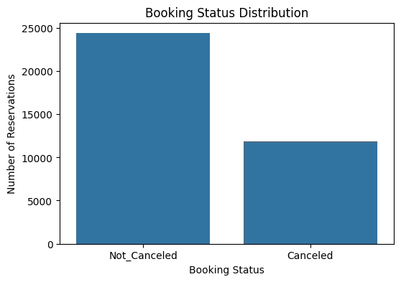
Key EDA Insights
~33% of bookings are cancelled
Higher lead time → higher cancellation risk
Longer stays and certain market segments cancel more
Repeated guests are less likely to cancel

Slide 6
Data Preprocessing
Target encoding
Feature engineering (total guests, total nights)
One-hot encoding for categorical variables
Feature scaling (StandardScaler)
Train–test split (80:20, stratified)

Slide 7
Machine Learning Models
Models Used
Logistic Regression (baseline)
Decision Tree
Random Forest
Evaluation Metrics
Accuracy
Precision, Recall, F1-Score
Confusion Matrix

Slide 8
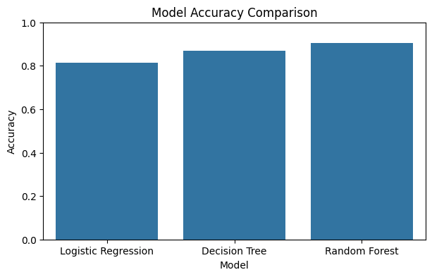
Model Comparison
Logistic Regression → baseline performance
Decision Tree → captures non-linear patterns
Random Forest → best overall performance

Slide 9
Final Model & Tuning
Hyperparameter tuning using GridSearchCV
Improved accuracy and generalization
Final Model: Tuned Random Forest Classifier
Result: Reliable prediction of booking cancellations

Slide 10
Conclusion & Future Scope
Conclusion
Machine learning effectively predicts hotel cancellations
Helps improve revenue and operational planning
Future Scope
Real-time deployment
Advanced models (XGBoost)

